Slide 1
Introduction to Java Programming
Lab # 02
By
Dr. Abdul Nasir Khan

Slide 2
Outline
How to set environment variable
Basic Structure of Java Program
Command Line Program Execution
javac
java

Slide 3
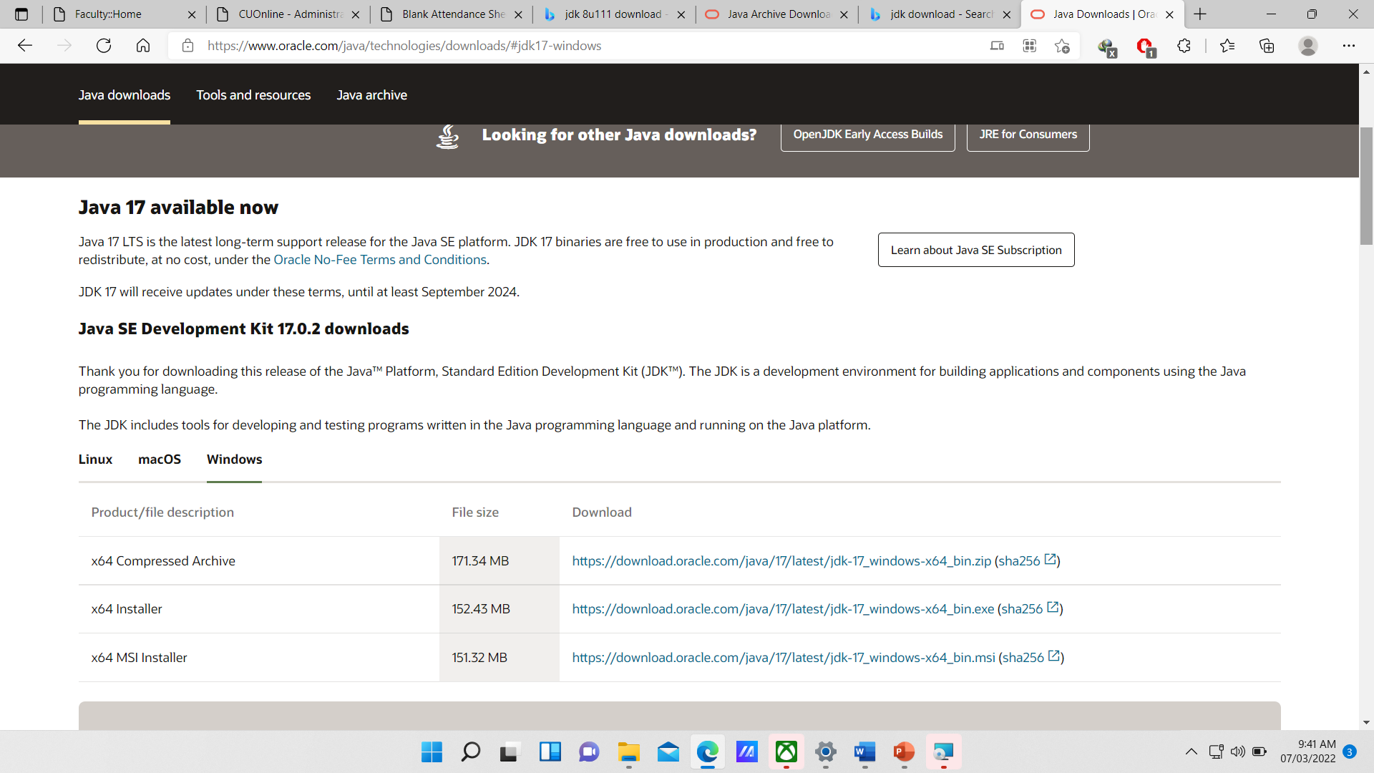
Download JdK
https://www.oracle.com/java/technologies/javase/javase8-archive-downloads.html
https://www.oracle.com/java/technologies/downloads/#jdk17-windows

Slide 4
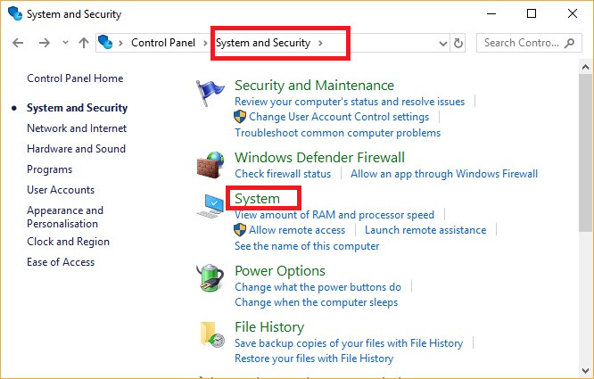
How to set environment variable
Step 1
Open Control Panel. Go to System & Security. Open System. or
Right Click on My Computer and goto Properties.

Slide 5
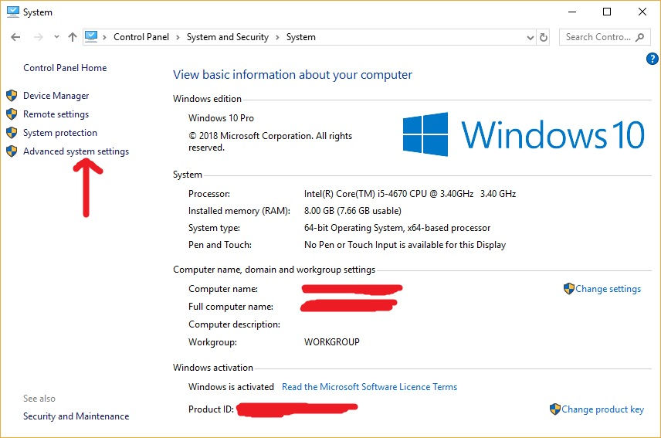
Step 2
Here you can see your computer hardware specifications like RAM, Processor Type and Windows Activation status etc. Go to Advanced System Settings on the left side.

Slide 6
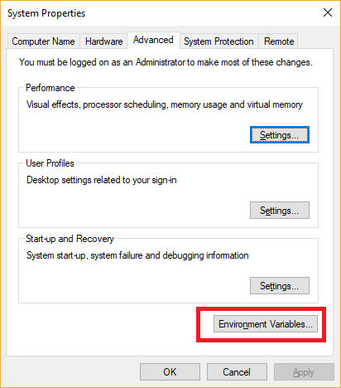
Step 3
Under system properties, go to Advanced Tab. On the bottom, you can find a button with name 'Environment Variables..'. Just click.

Slide 7
Step 4
Under Environment Variables, you can see two sections. The top section shows User variables and the bottom section shows System Variables. In either of them, find for Variable name PATH or path. If it is not available click New on any section and add PATH as variable NAME and Value as C:\Program Files\Java\jdk1.8.0_131\bin for example.
If the PATH variable is already existing in any section, simply click Edit and add the Java Installation Path.

Slide 8
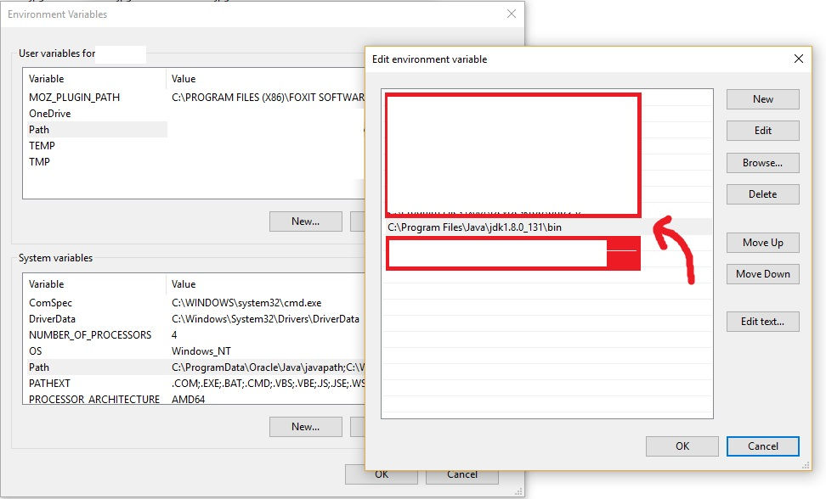
Continued…

Slide 9
How to compile program using command line

Slide 10
Program
Write the following program using any text editor and save it with the extension of .java.
public class test
{
public static void main(String[] arg)
{
System.out.println("Nasir Khan");
}
}
The name of class and file must be same.

Slide 11
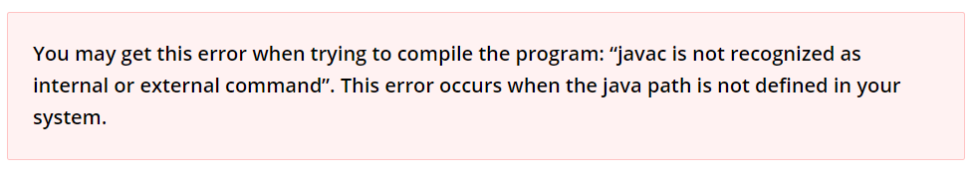
Compile
In this step, we’ll compile the program. To do this, open the Command Prompt (CMD) in Windows, if you are on Mac OS, open Terminal.
To compile the program, type the following command and press Enter.
javac filename.java

Slide 12
Run
Step 4: After compilation, the .java file is translated to the .class file (byte code). We can now run the program. To run the program, type the below command and press Enter:
java filename

Slide 13
Parameters used in First Java Program
class keyword is used to declare a class in Java.
public keyword is an access modifier that represents visibility. It means it is visible to all.
static is a keyword. If we declare any method as static, it is known as the static method. The core advantage of the static method is that there is no need to create an object to invoke the static method. The main() method is executed by the JVM, so it doesn't require creating an object to invoke the main() method. So, it saves memory.
void is the return type of the method. It means it doesn't return any value.

Slide 14
Continued…
main represents the starting point of the program.
String[] args or String args[] is used for command line argument. We will discuss it in coming section.
System.out.println() is used to print statement. Here, System is a class, out is an object of the PrintStream class, println() is a method of the PrintStream class. We will discuss the internal working of System.out.println() statement in the coming section.

Slide 15
Java Command Line Arguments
The java command-line argument is an argument i.e. passed at the time of running the java program.
The arguments passed from the console can be received in the java program and it can be used as an input.
public class test
{
public static void main(String[] arg)
{
for(int i=0; i<arg.length; i++)
{
System.out.println(arg[i]);
}
}
}

Slide 16


Compile
Run
Notes:
import

Slide 17
